Slide 1
Weekly report: Foundations
Week number: 8
Date: 11/11/2025
Supervisor: Prof. Dr.-Ing. Torsten Faber
Group members : Jehad Albaali- Amgad Gerges - Reda Deif
presented by : Reda Deif

Slide 2
List of contents
Design of Raft for bending moment
Next tasks
Group members: Jehad Albaali- Amgad Gerges - Reda Deif
Foundations team/ Optimus Syria

Slide 3
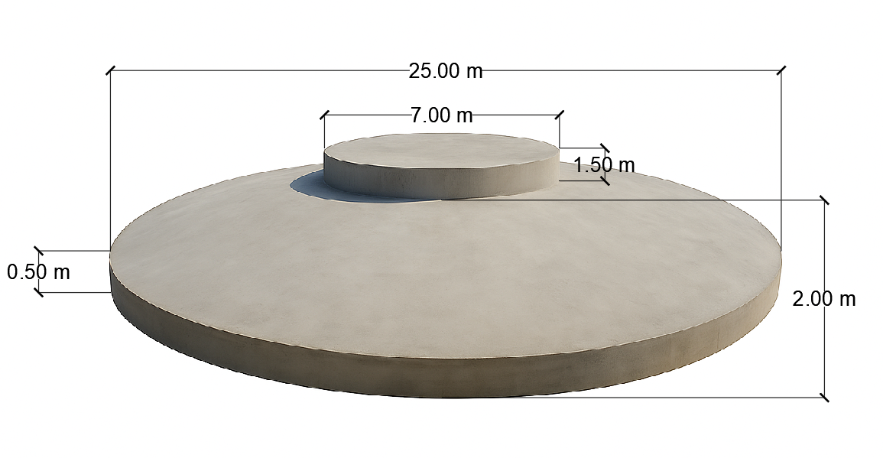
Concrete Dimensions
Diameter of Base Plate (BP) = 25 m
Diameter of Pedestal = 7 m
Height Pedestal = 1.5 m
Height of Middle slab = 2 m
Height of Frustum (HF) = 1.5 m
Height of Edge slab (HE) = 0.5 m
Group members: Jehad Albaali- Amgad Gerges - Reda Deif
Foundations team/ Optimus Syria

Slide 4
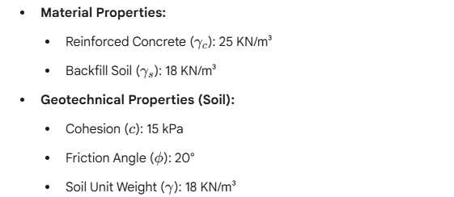
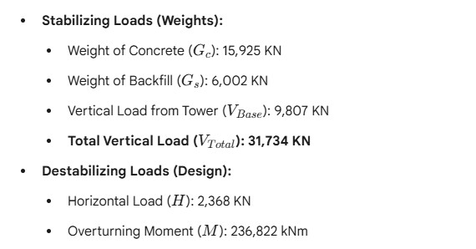
Input data
Group members: Jehad Albaali- Amgad Gerges - Reda Deif
Foundations team/ Optimus Syria

Slide 5
Design of Raft for bending moment
Circular Foundation Parameters :
Diameter D = 25 m → radius r = 12.5 m
Ultimate overturning moment M= 236,822 kN·m
Concrete thickness h = 2.0 m
Reinforcement design for bending due to overturning moment
Group members: Jehad Albaali- Amgad Gerges - Reda Deif
Foundations team/ Optimus Syria

Slide 6
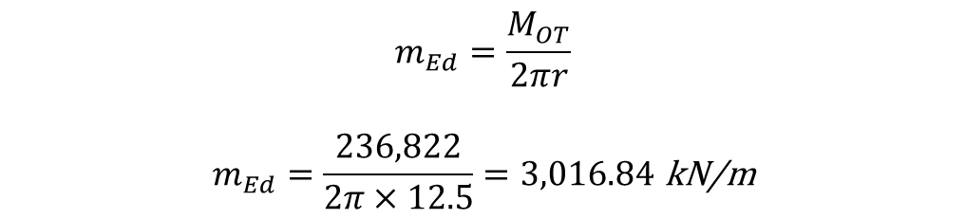
Moment per unit width at foundation edge
$$m_{Ed}=\frac{M_{OT}}{2πr}$$
$$m_{Ed}=\frac{236,822}{2π×12.5}=3,016.84 \text{kN}\text{/}\text{m}$$
Group members: Jehad Albaali- Amgad Gerges - Reda Deif
Foundations team/ Optimus Syria

Slide 7
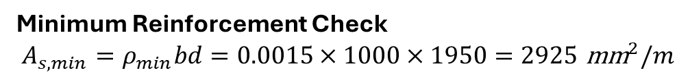
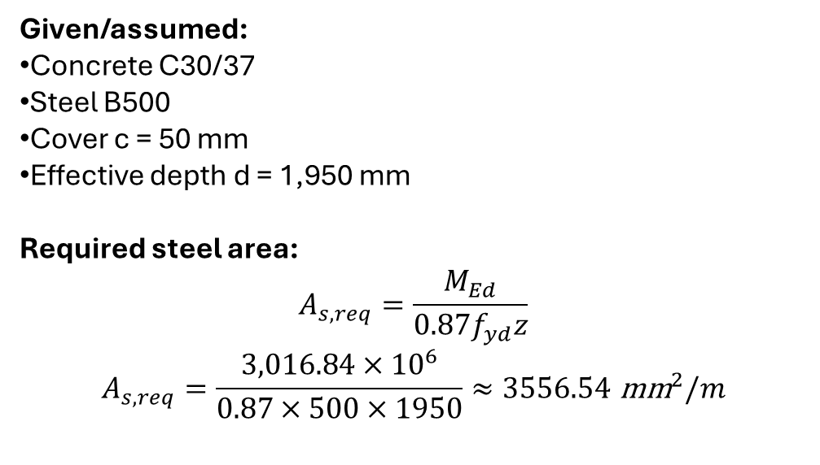
Reinforcement Calculation
Given/assumed:
Concrete C30/37
Steel B500
Cover c = 50 mm
Effective depth d = 1,950 mm
Required steel area:
$$A_{s,req}=\frac{M_{Ed}}{0.87f_{yd}z}$$
$$A_{s,req}=\frac{3,016.84×{10}^{6}}{0.87×500×1950}≈3556.54 {\text{mm}}^{2}/m$$
Reference :
Concrete grades according to EC 2 and DIN 1045-1 (2008)
EN 1992 – Eurocode 2: Design of Concrete Structures
Minimum Reinforcement Check
$$A_{s,min}=ρ_{min}bd=0.0015×1000×1950=2925 {\text{mm}}^{2}/m$$
$A_{s,req}$ > $A_{s,min}$
Group members: Jehad Albaali- Amgad Gerges - Reda Deif
Foundations team/ Optimus Syria

Slide 8
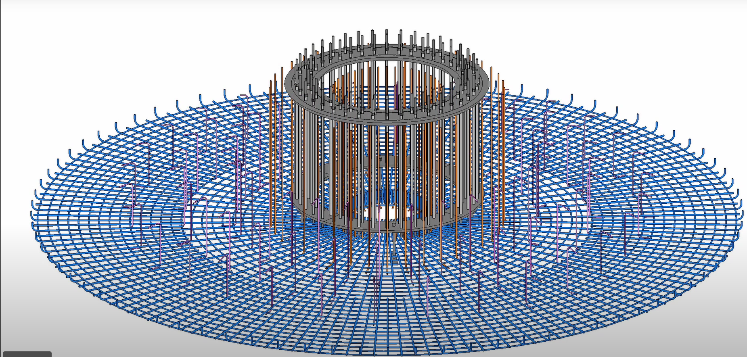
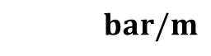
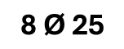
Reinforcement Calculation
$$Using \text{Ø}\text{25 }\text{mm}$$
$$A_{s,bar }$$
$=$ $\text{490.87 }\text{mm}\text{²}$
$$no. of bars=\text{7}\text{.}\text{24} \text{Ø }\text{25 }\text{/ }\text{m}$$
$$=$$
$$bar/m$$
$$\text{8 }\text{Ø} \text{25}$$
Reference :
*$\text{Foundation} \text{WS} \text{2025}\text{/}\text{26 }\text{Prof}\text{. }\text{Dr}\text{.}\text{−}\text{Ing}\text{. }\text{Torsten} \text{Faber}$
Group members: Jehad Albaali- Amgad Gerges - Reda Deif
Foundations team/ Optimus Syria

Slide 9
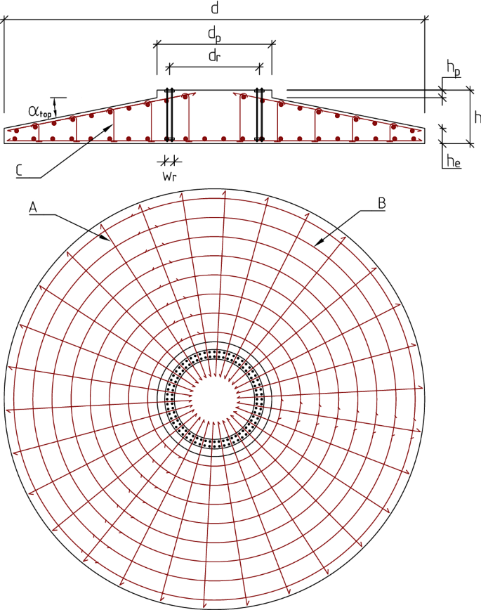


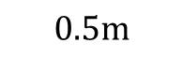
Shop drawing
$$=$$
$$=25m$$
$$=$$
$$7m$$
$$2m$$
$$=$$
$$=$$
$$0.5m$$
$$\text{8 }\text{Ø} \text{25}$$
$$\text{8 }\text{Ø} \text{25}$$
Group members: Jehad Albaali- Amgad Gerges - Reda Deif

Slide 10
Time Schedule Planning
Time Schedule Planning
Week 1-2: Data Collection & Project Kick-off
Week 3-4: Geotechnical Analysis & Conceptual Design
Week 5-7: Detailed Design & Verification
Week 8-9: Structural Design (Rebar & Shear)
Week 10-11: Final Drawings & Documentation
Week 12: Final Review & Submission
Group members: Jehad Albaali- Amgad Gerges - Reda Deif
Foundations team/ Optimus Syria

Slide 11
Next Tasks
Design of Raft for shear
Group members: Jehad Albaali- Amgad Gerges - Reda Deif
Foundations team/ Optimus Syria

